Slide 1



MY AADHAAR
CHECK IN EVERYWHERE WITH PROPER VARIFICATION AT EASE
SHIBPUR WIZARDS
October 28 - 31, 2021

Slide 2
OUR TEAM
Abhinaba Chowdhury (abhinabachowdhury@gmail.com)
Snehasish Dhar (dsnehasish74@gmail.com)
Devtanu Misra (devtanumisra@gmail.com)
Md. Enjamum Hossain (h.enjamum@gmail.com)
Malay Gain (malaygain10@gmail.com)

Slide 3
Problem Statement
Airport / Stadium / Railway Station / Hotel Check-in Application:
How could we use Aadhaar services to create an application for smooth check-in to a Airport/Railway Station/Hotel etc ? Please remember that the Aadhaar number should not be shared with the verifier application. In addition, the verifier application should be assumed to have no access to UIDAI servers. The application should work offline and provide a sub-second end-to-end response time.

Slide 4
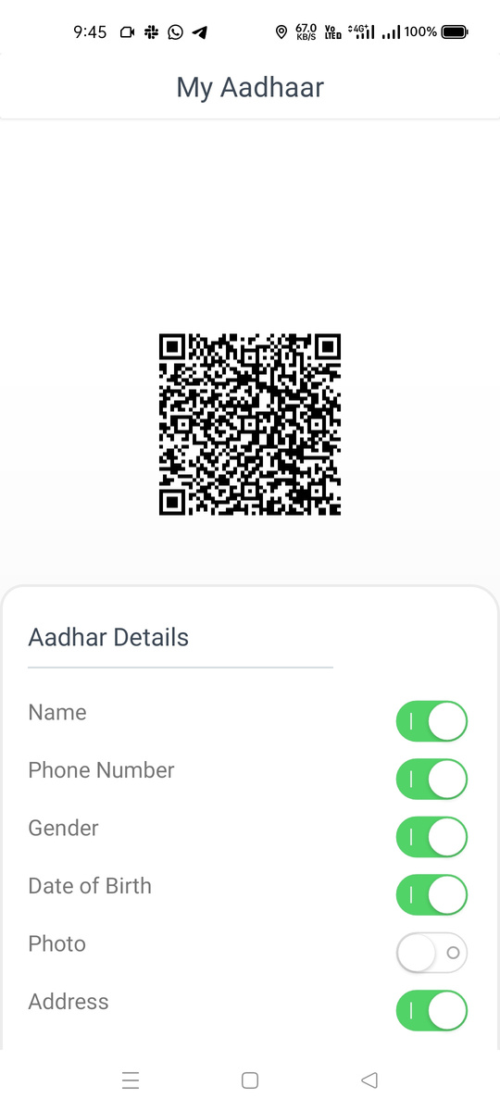
Solution
2 APPS TO VERIFY YOUR IDENTITY
Resident Application with the user to retrieve the Aadhaar data and create QR code.
Verifier Application with the authenticator and receives data in encrypted form from the user and helps in easy paperless check-in.

Slide 5
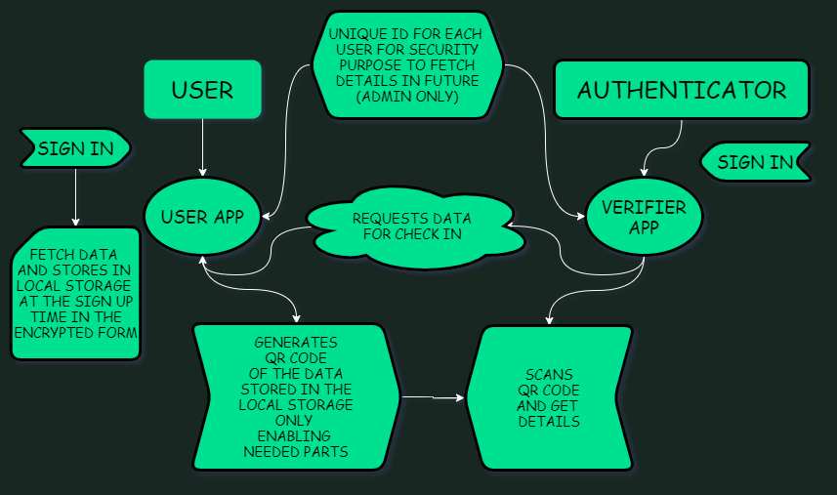

Slide 6
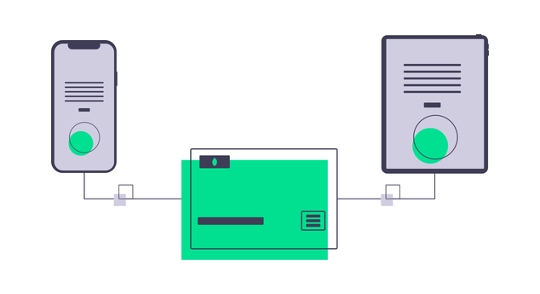


SALIENT FEATURES
OFFLINE
SECURE
SHARE WHAT YOU NEED
Install our app and use it offline without any hassle.
Complete paperless and secure encrypted transaction.
Share only what's relevant without any unnecessary information.

Slide 7
OTP API
AUTH API
This API helps us get the OTP in the registered mobile number of the user.
Verifies if the user is authnetic or not.
API USED
VID WRAPPER API
EKYC API
Generation of vid cirresponding to the Aadhaar so that user doesn't have to use the aadhaar.
Fetching all the necessary information ro the user.

Slide 8
Security Considerartions
ENCRYPTION
Data transactions and storage are in an encrypted format and the authenticator doesn't have access to any UIDAI server.
ACCESS TO VERIFIED AUTHENTICATOR
Only a verified authenticator can retrieve the data and no other application can get access to the Aadhaar data because of end to end encryption.

Slide 9

Thank You

